Slide 1

Laboratory & Professional skills for Bioscientists Term 2: Data Analysis in R
One sample tests: one-sample t-test, paired-sample t-test and one-sample Wilcoxon

Slide 2
Summary of this week and next
We will consider tests for one-, two- and paired-samples. These are the t-tests and their non-parametric equivalents. We will apply what we know about choosing appropriate tests
Two lectures.

Slide 3
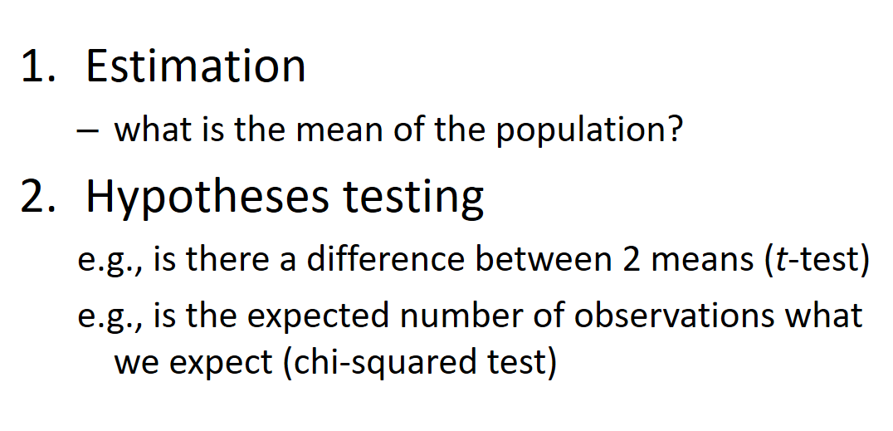
Overview of topics
Week | Topic
2 | Introduction. Logic of hypothesis testing
3 | Hypothesis testing, variable types
4 | Chi-squared tests
5 | The normal distribution, summary statistics and CI
6 and 7 | One- and two-sample tests (2 lectures)
8 | One-way ANOVA and Kruskal-Wallis
9 | Two-way ANOVA incl understanding the interaction
10 | Correlation and regression
Foundation
Hypothesis testing
Estimation
Hypothesis testing
Lecture 2

Slide 4
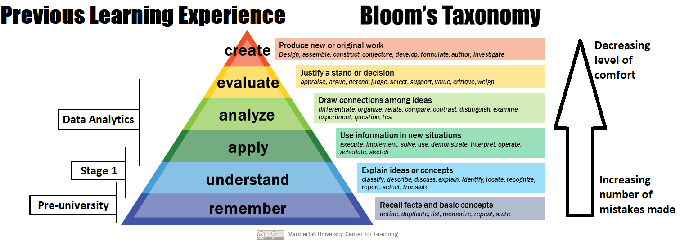
“It’s hard………”

Slide 5
Learning objectives for the 2 weeks
By actively following the lecture and practical and carrying out the independent study the successful student will be able to:
Explain dependent and independent samples (MLO 2)
Select, appropriately, t-tests and their non-parametric equivalents (MLO 2)
Apply, interpret and evaluate the legitimacy of the tests in R (MLO 3 and 4)
Summarise and illustrate with appropriate R figures test results scientifically (MLO 3 and 4)

Slide 6
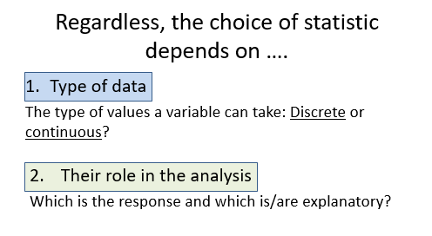
Revision Lectures 1 and 2 Choosing tests

Slide 7
Choosing tests: 3 steps
What is a one sentence description of what you want to know?
What are your explanatory variables?
Categories: t-tests, ANOVA, Wilcoxon, Mann-Whitney
Continuous: Regression, correlation
What is your response variable?
Normally distributed: t-tests, ANOVA, regression
Counts: Chi-squared or stage 2 ☺

Slide 8
Choosing tests: 3 steps
What is a one sentence description of what you want to know?
What are your explanatory variables?
Categories: t-tests, ANOVA, Wilcoxon, Mann-Whitney
Continuous: Regression, correlation
What is your response variable?
Normally distributed: t-tests, ANOVA, regression
Counts: Chi-squared or stage 2 ☺

Slide 9
Types of t-test
One-sample
Compares the mean of sample to a particular value (compares the response to a reference)
Includes paired-sample test – compares the mean difference to zero (i.e., compares dependent means)
Two-sample
Compares two (independent) means to each other

Slide 10
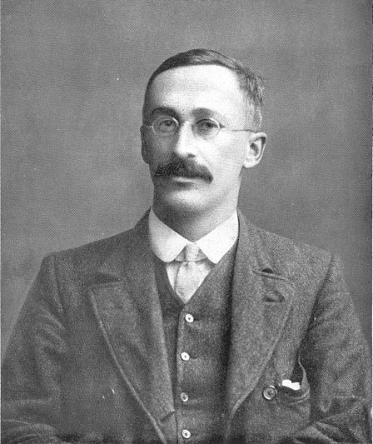
t-tests
Student’s t-test
‘Student’ was William Sealy Gosset

Slide 11
t-tests in general Assumptions
All t-tests assume the “residuals” are normally distributed and have homogeneity of variance
A residual is the difference between the predicted and observed value
Predicted value is the mean / group mean

Slide 12
t-tests in general: assumptions Checking Assumptions
- Common sense
Data should be continuous
No/few repeats
- Plot the residuals
- Using a test in R

Slide 13
t-tests in general: assumptions When data are not normally distributed
Transform (not really covered)
E.g. Log to remove skew, arcsin squareroot on proportions
Use a non-parametric test (covered)
Fewer assumptions
Generally less powerful

Slide 14

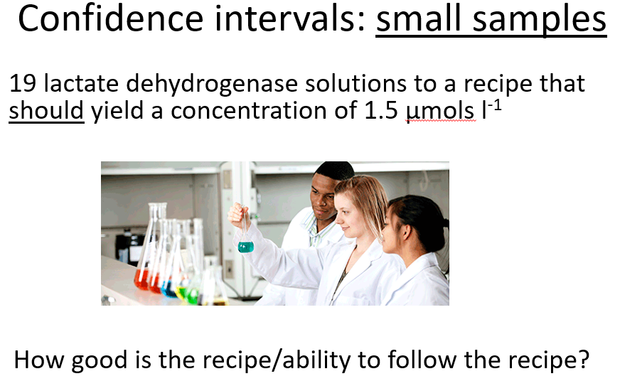
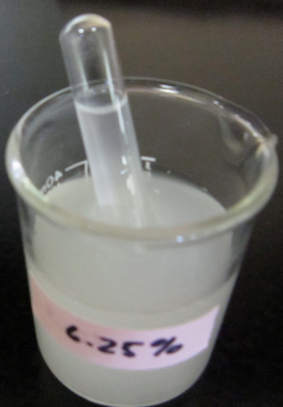
t-tests One-sample t-tests
We often want to know if the mean of a sample differs from some reference value
Comparing a measure of water quality to a reference value
Validating a method to determine Glucose concentration
Notes:
Comparison of some measure of water quality to a reference value
Using a new Glucose oxidase method to determine glucose concentration on a known conc to validate method

Slide 15
t-tests One-sample t-tests
Tests whether the mean of a single sample differs from an expected value (i.e., H₀)
Example: Fields are sprayed if crop plants have a disease score* of 76.
20 plants in a field are measured
Is their mean significantly different from the reference of 76?
*Arbitrary scale

Slide 16
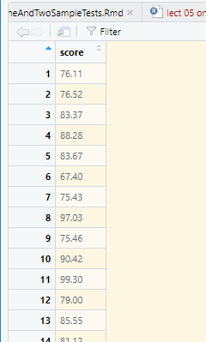
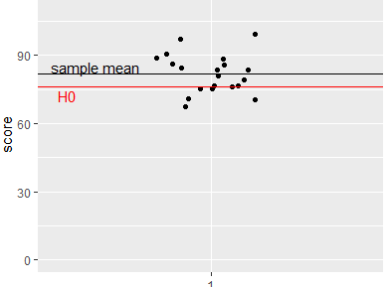
t-tests One-sample t-tests - example
score %>%
summarise(mean(score),
sd(score),
length(score))
mean(score) sd(score) length(score)
1 81.803 8.533749 20
Notes:
Null hypothesis has been covered in first lecture

Slide 17
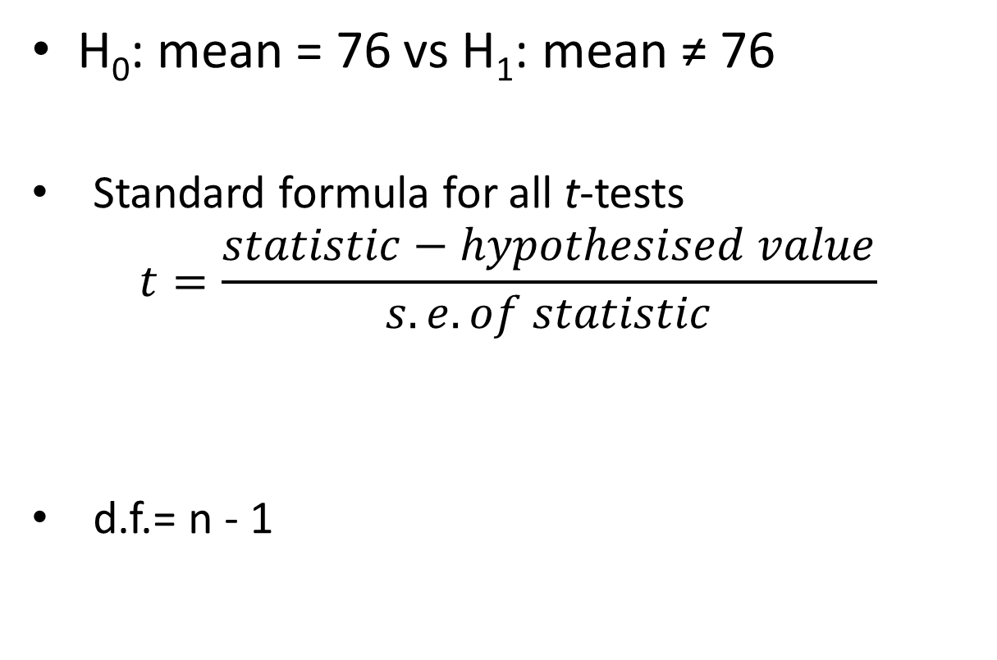
t-tests One-sample t-tests - example
H₀: mean = 76 vs H₁: mean ≠ 76
Standard formula for all t-tests
$$t=\frac{statistic−hypothesised value}{s.e. of statistic}$$
d.f.= n - 1
Notes:
The size of t depends both on the amount of difference and the variation

Slide 18
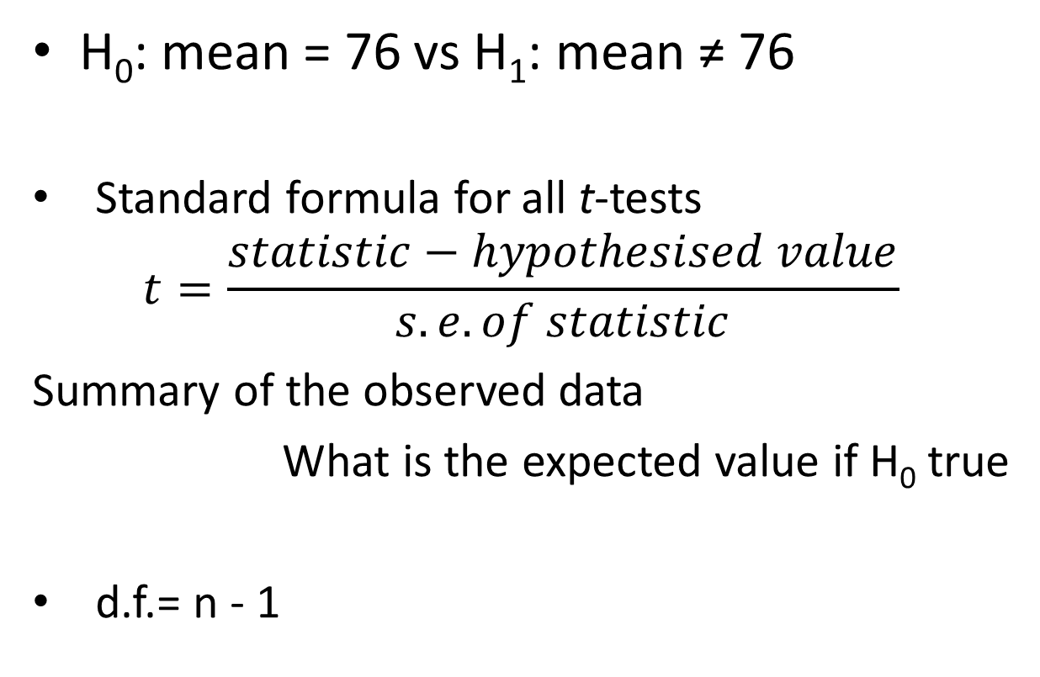
t-tests One-sample t-tests - example
H₀: mean = 76 vs H₁: mean ≠ 76
Standard formula for all t-tests
$$t=\frac{statistic−hypothesised value}{s.e. of statistic}$$
Summary of the observed data
What is the expected value if H₀ true
d.f.= n - 1
Notes:
The size of t depends both on the amount of difference and the variation

Slide 19
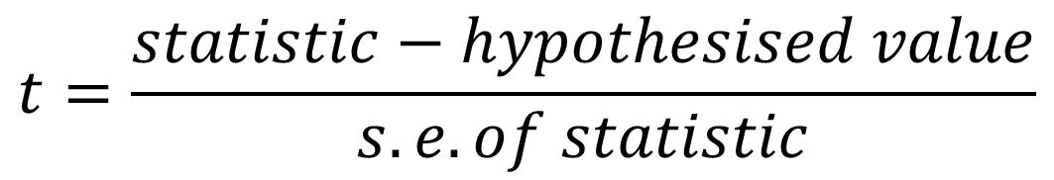
t-tests One-sample t-tests - example
$$t=\frac{statistic−hypothesised value}{s.e. of statistic}$$
Is the difference between the obtained value and the expected value big relative to the variability?

Slide 20
t-tests One-sample t-tests - example
Run the t-test
Manual:
t.test(x, y = NULL, alternative = c("two.sided", "less", "greater"), mu = 0, paired = FALSE, var.equal = FALSE, conf.level = 0.95, ...)

Slide 21
t-tests One-sample t-tests - example
t.test(data = score, score, mu = 76)
One Sample t-test
data: score
t = 2.517, df = 19, p-value = 0.02097
alternative hypothesis: true mean is not equal to 77
95 percent confidence interval:
77.80908 85.79692
sample estimates:
mean of x
81.803

Slide 22
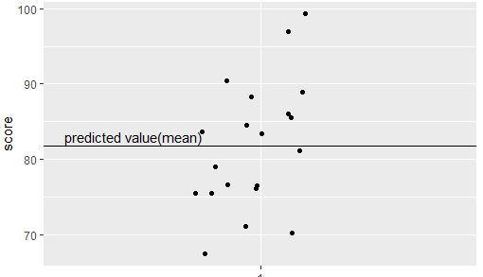
t-tests One-sample t-tests - example
Checking the assumptions: normally and homogenously distributed residuals
Residual

Slide 23
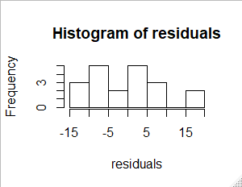
t-tests One-sample t-tests - example
Checking the assumptions: normally and homogenously distributed residuals
residuals <- score$score - mean(score$score)
hist(residuals)
shapiro.test(residuals)
Shapiro-Wilk normality test
data: residuals
W = 0.9725, p-value = 0.8065

Slide 24
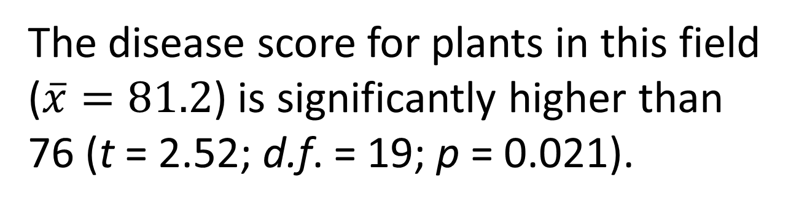
t-tests One-sample t-tests - example
Reporting the result: “significance of effect, direction of effect, magnitude of effect”
The disease score for plants in this field ($\overline{x}=81.2$) is significantly higher than 76 (t = 2.52; d.f. = 19; p = 0.021).

Slide 25
t-tests Paired-sample t-tests
Really a one-sample test
Two samples but values are not independent (could not reorder)
N.b. not ‘tidy’ data
Patient | Drug | Placebo
1 | 14 | 18
2 | 26 | 29
3 | 21 | 24
etc

Slide 26
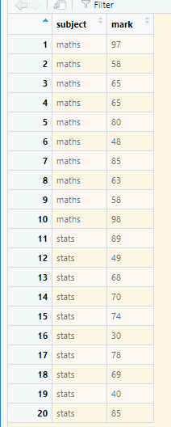
Is there a difference between the maths and stats marks of 10 students? The one sample is the difference between the pairs of values n.b. tidy data
t-tests Paired-sample t-tests example
Same student

Slide 27
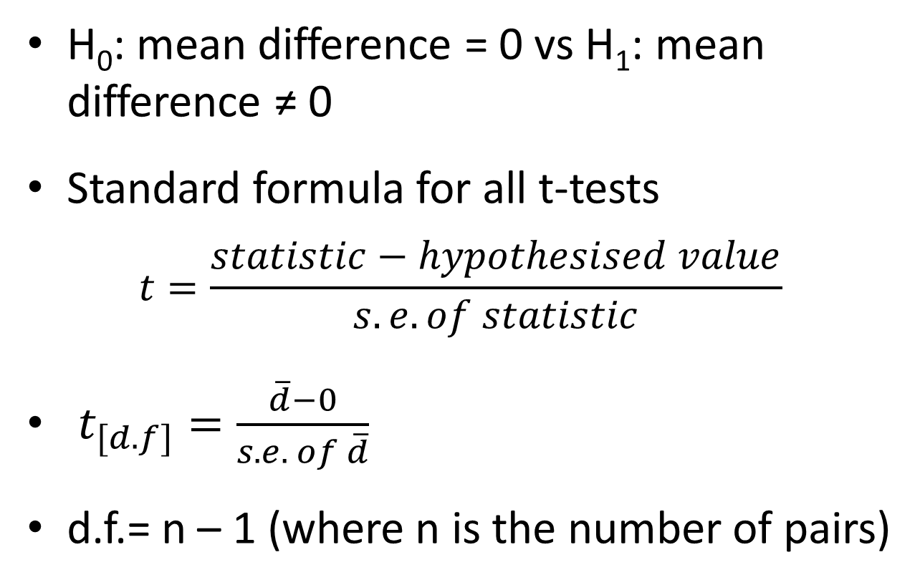
t-tests Paired-sample t-tests - example
H₀: mean difference = 0 vs H₁: mean difference ≠ 0
Standard formula for all t-tests
$$t=\frac{statistic−hypothesised value}{s.e. of statistic}$$
$t_{[d.f]}=\frac{\overline{d}−0}{s.e. of \overline{d}}$
d.f.= n – 1 (where n is the number of pairs)
Notes:
i.e., the number in the sample of differences

Slide 28
t-tests Paired-sample t-tests
Run paired sample t-test
t.test(data = marks, mark ~ subject, paired = TRUE)
Paired t-test
data: mark by subject
t = 2.3399, df = 9, p-value = 0.04403
alternative hypothesis: true difference in means is not equal to 0
95 percent confidence interval:
0.2159788 12.7840212
sample estimates:
mean of the differences
6.5

Slide 29
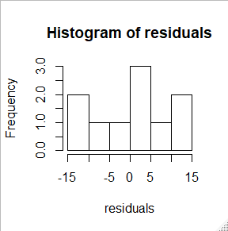
t-tests Paired-sample t-tests - example
Checking the assumptions: normally and homogenously distributed residuals
diffs <- marks$mark[marks$subject == "maths"] - marks$mark[marks$subject == "stats"]
residuals <- diffs - mean(diffs)
hist(residuals)
shapiro.test(residuals)
Shapiro-Wilk normality test
data: residuals
W = 0.91246, p-value = 0.2983

Slide 30
t-tests Paired-sample t-tests
Reporting the result: “significance of effect, direction of effect, magnitude of effect”
Individual students score significantly higher in maths than in statistics (t = 2.34; d.f. = 9; p = 0.044) with an average difference of 6.5%.

Slide 31
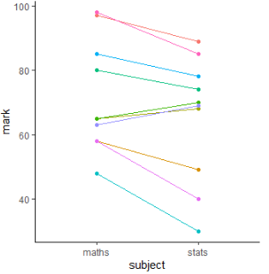
t-tests Paired-sample t-tests: figure

Slide 32
When the t-test assumptions are not met: non- parametric tests
Non-parametric tests make fewer assumptions
Based on the ranks rather than the actual data
Null hypotheses are about the mean rank (not the mean)

Slide 33
Non-parametric tests t-test equivalents
i,.e., the type of question is the same but the response variable is not normally distributed or it is impossible to tell (small samples)
one – sample t-test and paired-sample t-test: the one-sample Wilcoxon
Two-sample t-test (next lecture): two-sample Wilcoxon aka Mann-Whitney

Slide 34
Non-parametric tests one/paired-sample Wilcoxon
Marks – small sample.
Wilcoxon might be more appropriate
wilcox.test(data = marks, mark ~ subject, paired = TRUE)
Wilcoxon signed rank test with continuity correction
data: mark by subject
V = 48.5, p-value = 0.03641
alternative hypothesis: true location shift is not equal to 0
Warning message:
In wilcox.test.default(x = c(97L, 58L, 65L, 65L, 80L, 48L, 85L, :
cannot compute exact p-value with ties

Slide 35
Non-parametric tests one/paired-sample Wilcoxon
Reporting the result: “significance of effect, direction of effect, magnitude of effect”
Individual students score significantly higher in maths than in statistics (Wilcoxon: V = 48.5; n = 10; p = 0.036) with a median difference of 7.5%.

Slide 36
Learning objectives for the week
By attending the lectures and practical the successful student will be able to
Explain dependent and independent samples (MLO 2)
Select, appropriately, t-tests and their non-parametric equivalents (MLO 2)
Apply, interpret and evaluate the legitimacy of the tests in R (MLO 3 and 4)
Summarise and illustrate with appropriate R figures test results scientifically (MLO 3 and 4)

